Slide 1

AngularJS
Dependency manager : npm & bower

Slide 2
DO I need dependency management?
Yes!
Dependencies must not be mixed with app code base
Dependencies must be kept up to date
JavaScript projects use A LOT a dependencies
Ex: EDF NOVA project -> 4 month old and already 100+ deps

Slide 3
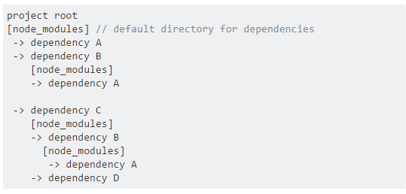
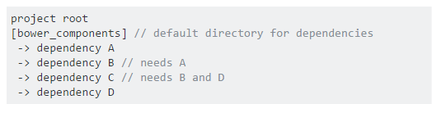
2 ways of managing dependencies
nested dependency tree
flat dependency tree

Slide 4
So which one is the best?
Nested dependency tree
Great on the server (don't have to care about space and latency)
No dependency conflict
/!\ Doesn't work that well on the front-end: imagine a site having to download three copies of jQuery.
Flat dependency tree
Only one version for each package
Minimal load (front-end friendly)
/!\ Dependency conflict must be dealt with by the developer
All package managers have many downsides. You just have to pick which you can live with.

Slide 5
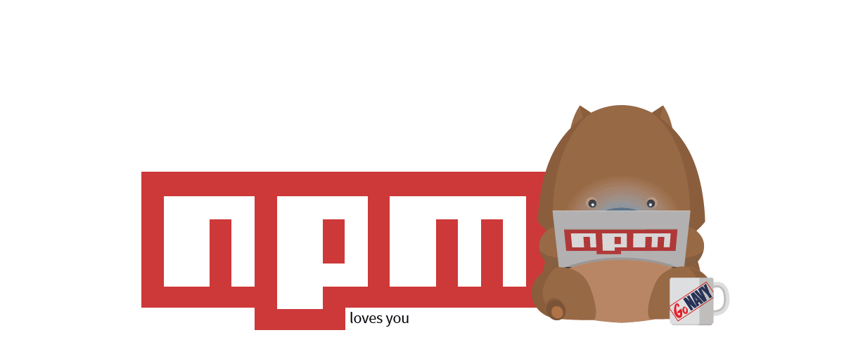
npm
Node Packet Manager
Node official registry: https://www.npmjs.com/
Most commonly used for managing Node.js modules (build tools)
Use a nested dependency tree: no dependency conflicts

Slide 6
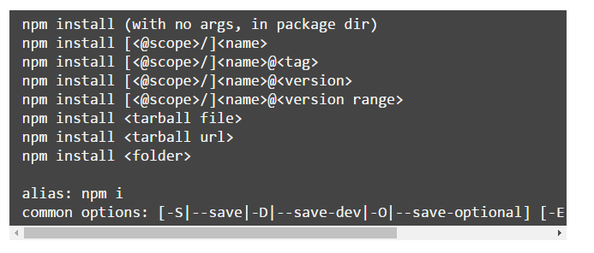
npm
Install a specific dependency:
Install all dependencies from package.json

Slide 7
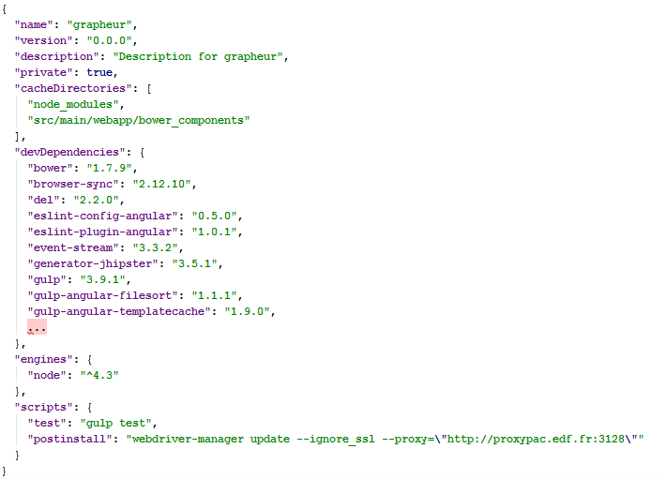
npm
Package.json

Slide 8


BOWER
Bower is a node packet
must be installed with npm:
Registry: https://bower.io/
Bower is created solely for the front-end and is optimized with that in mind: good for libraries that embedded in the app
Bower uses a flat dependency tree, requiring only one version for each package, reducing page load to a minimum.

Slide 9
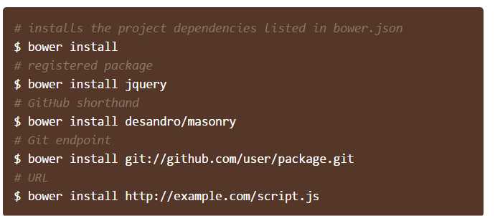
BOWER
Install a specific dependency:
Use –-save option to automatically add the package in bower.js
Install all dependencies from bower.json

Slide 10
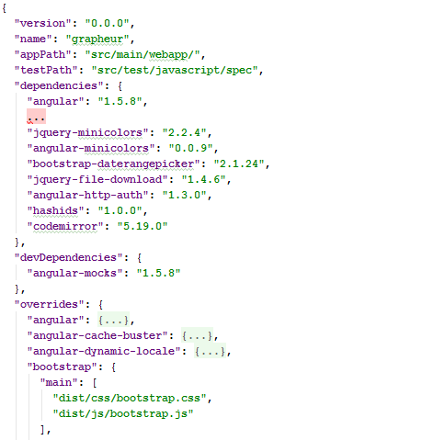
BOWER
bower.json (app)

Slide 11
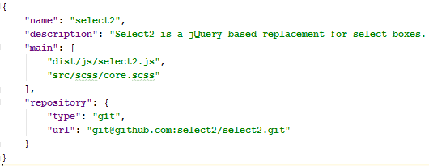
BOWER
bower.json (LIB)
Files in « main » property must be included in the app
Manually
Or using a build tool (ex: gulp-inject)

Slide 12
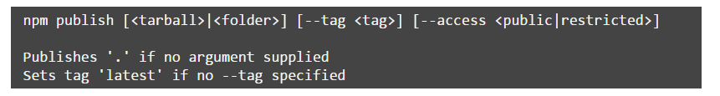
publishing
NPM
Project must have a valid package.json
Command:
The published code is uploaded to the npm registry
This must be done every time you tag a version

Slide 13
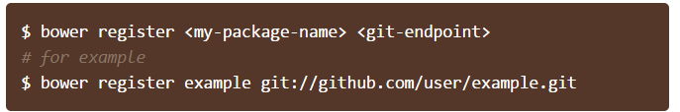
publishing
bower
Project must have a valid bower.json
Command:
Bower registry only store the git endpoint
Every tag on the git project is available as a tag in the bower registry
Must be done only once, just push a git tag to create a new version

Slide 14
publishing
Custom registry
Why do we need an on-premise registry?
Proxy repository:
Keep build servers from accessing internet
Limit bandwidth usage
Hosted repository:
Works with on-premise git endpoint
Nexus can be used as custom registry for frontend dependencies
Version 2 & 3 for npm registry
Version 3 only for bower registry
Bower does not natively support custom registry: bower-nexus3-resolver must be installed (https://www.npmjs.com/package/bower-nexus3-resolver)

Slide 15
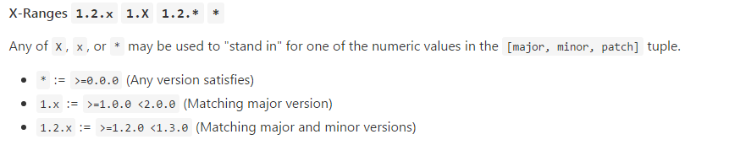
Semver
Format: X.Y.Z (Major.Minor.Patch)
MAJOR version when you make incompatible API changes,
MINOR version when you add functionality in a backwards-compatible manner, and
PATCH version when you make backwards-compatible bug fixes.
Ranges:

Slide 16
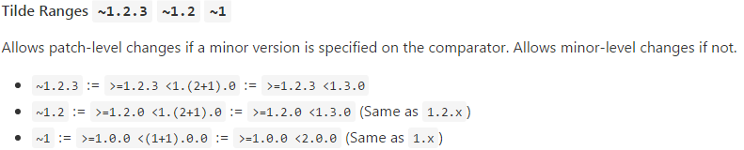
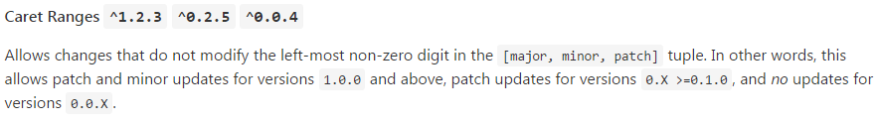

Semver
When in doubt: http://semver.org/ & https://semver.npmjs.com/

Slide 17
some words of advice
Don't trust anyone, specially for « small » dependencies
Do not use ranges to keep control of your dependencies
Do not update blindly: most of your libs are on github
Read the changelog
Browse the code & commits
Use a tool to help you manage updates: https://www.npmjs.com/package/npm-check-updates
Be aware: The dependencies you are using may use ranges for their own dependencies…

Slide 18
some words of advice
Dependency management is essential, especially in a fast moving ecosystem like JavaScript
Dependency management must be a task in the project lifecycle:
It must be discussed by the team
It must be planned
It must be tested

